Slide 1

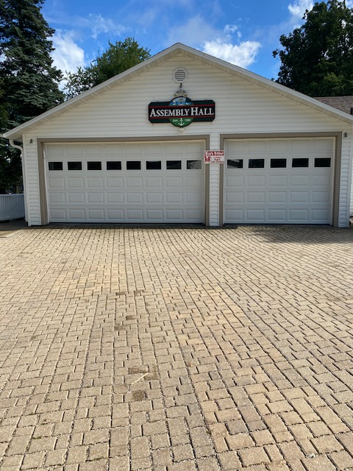
Assembly Park
Assembly Hall Committee

Slide 2
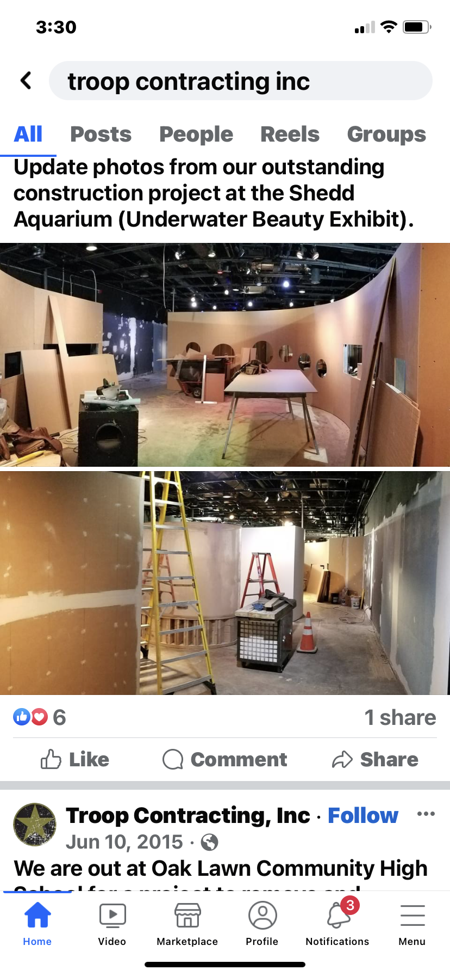
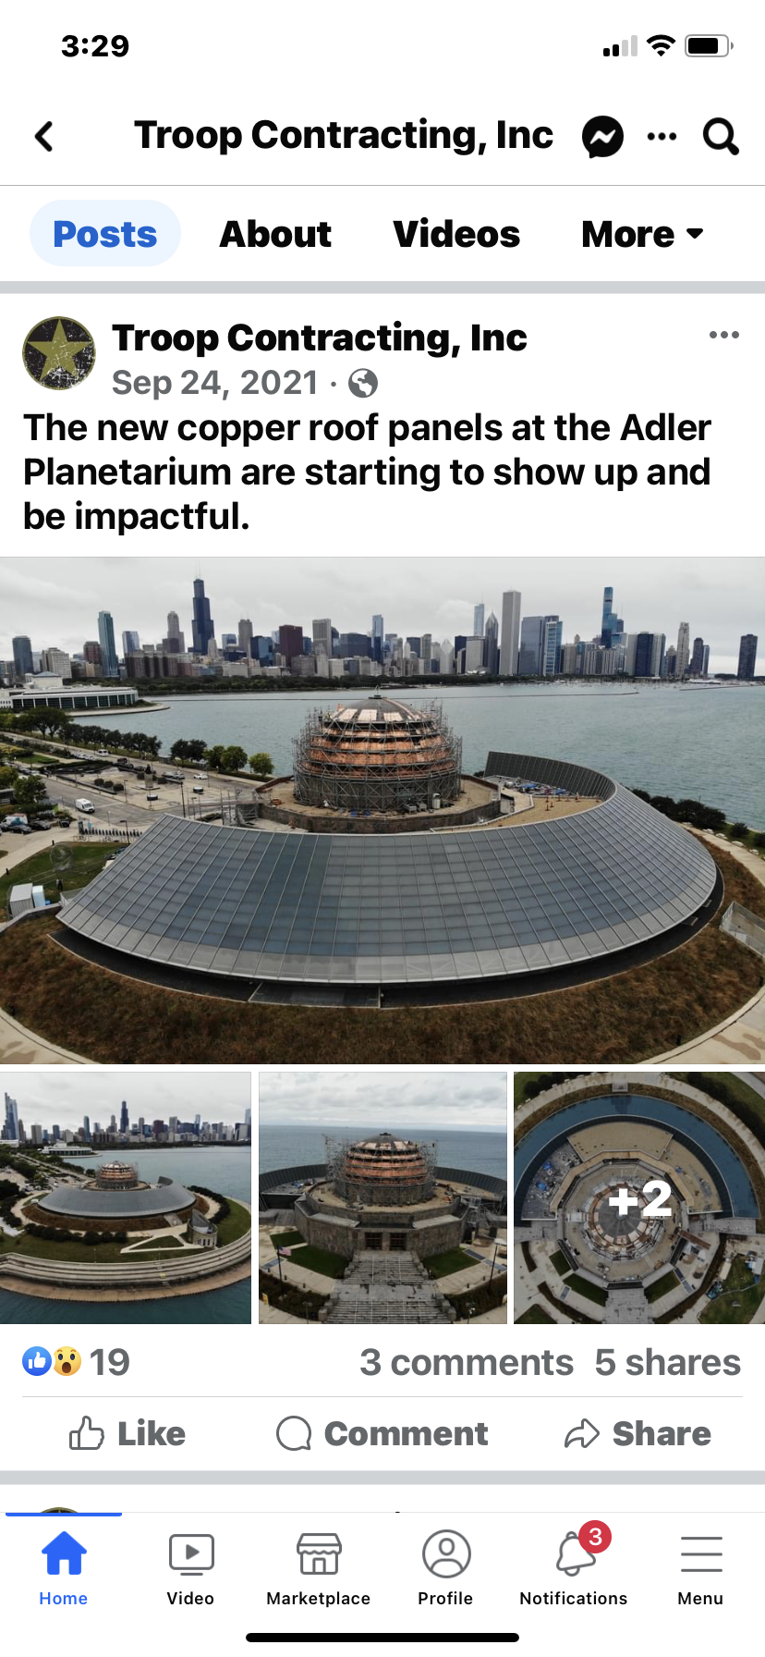
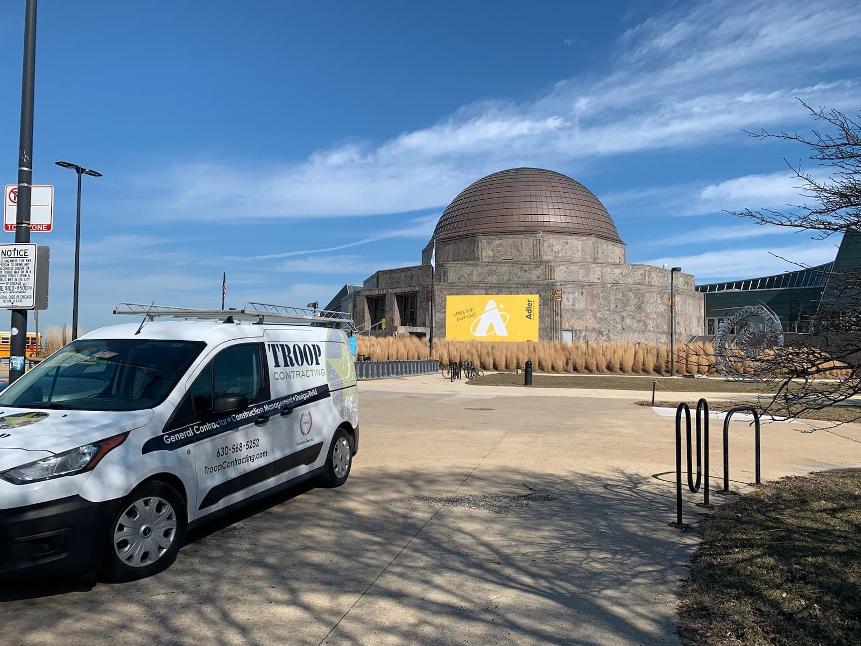
Brian Hatlen
President / Owner Troop Contracting Inc
  Troop Contracting
    Full Service Commercial General Contractor
    Specializing in design –build and JOC projects
  At our request Brian inspected the Hall

Slide 3
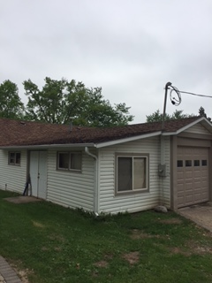
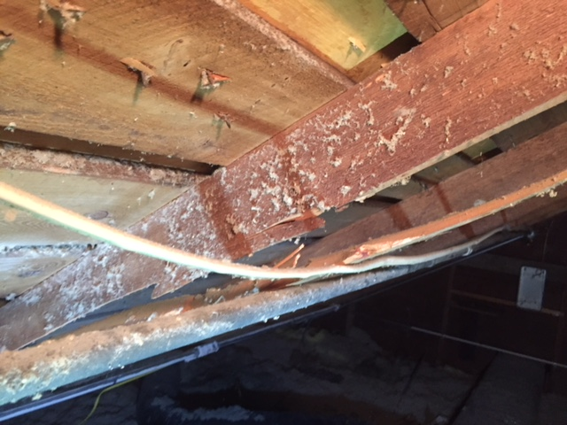
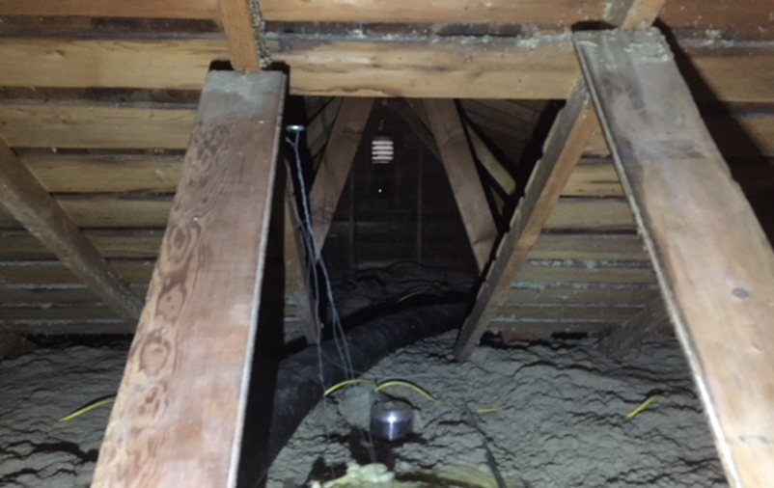
Assembly Hall’s Current Condition
Roof
  Rafters are 2 x 4 on 24” centers which are not up to code
  There are broken rafters
  Low roof pitch has poor drainage and weight distribution
    Poor water run off and snow/ice buildup
    Excessive wear on shingles, decking, trusses and structure
  The roof was replaced, and a rafter fixed in January 2021 ($11,400)
  The roof and rafter structure will need to be replaced and pitched properly

Slide 4
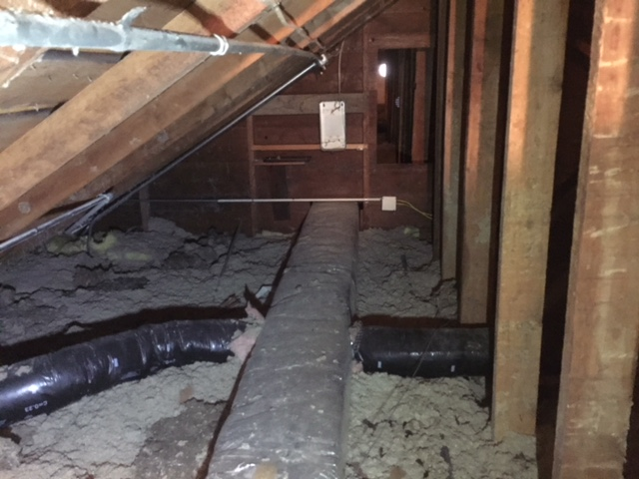
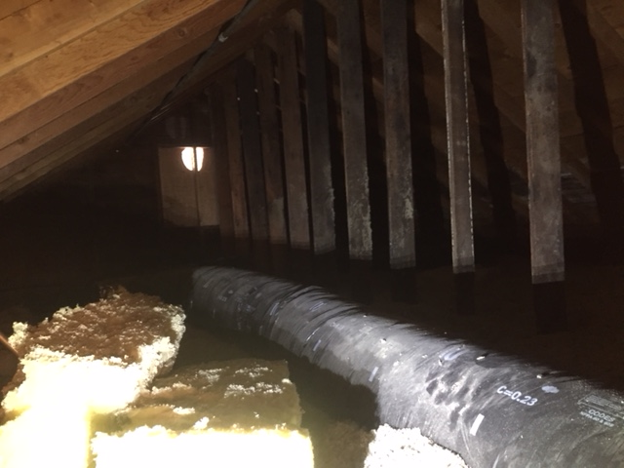
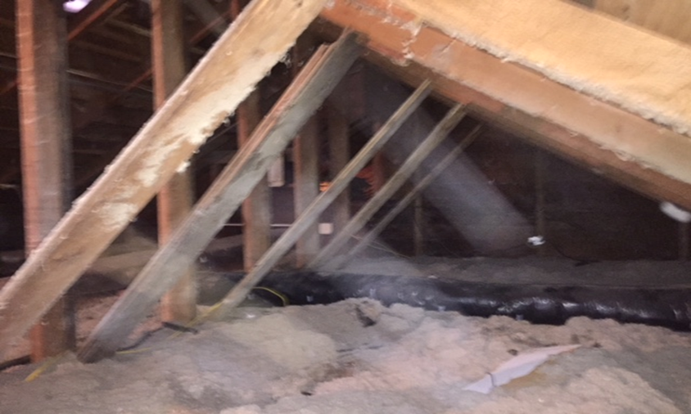
Assembly Hall’s Current Condition
Insulation
Current insulation does not meet Wisconsin building code
  Poor insulation in the ceiling drives higher energy bills year-round.
  Water damage and missing insulation
  Doors and windows are not energy efficient

Slide 5
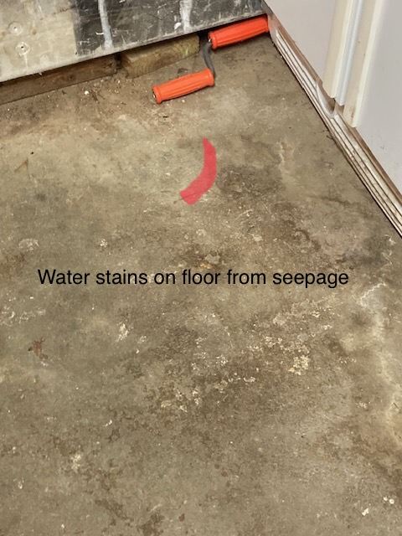
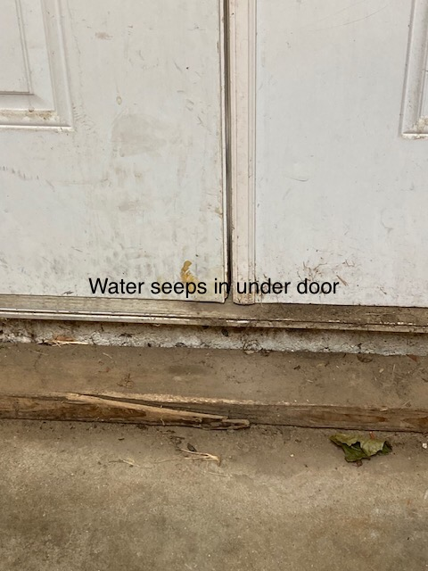
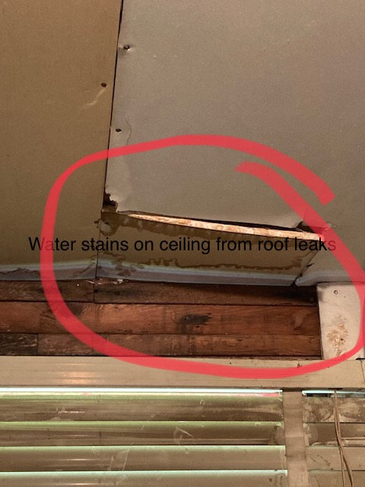
Assembly Hall’s Current Condition
Water Damage
  There is evidence of water damage

Slide 6
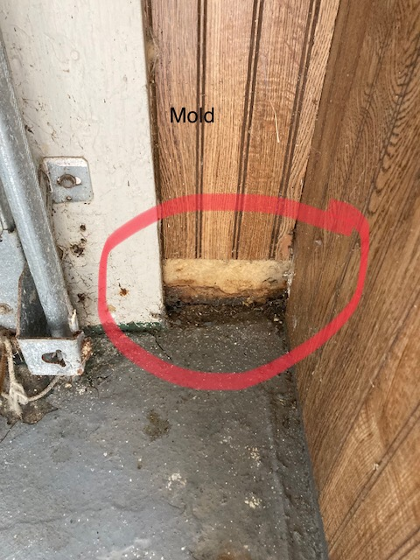
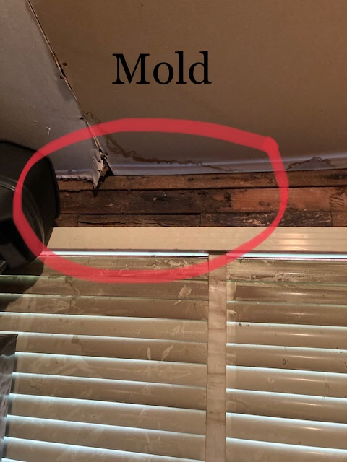
Assembly Hall’s Current Condition
Mold
  We had the Hall inspected by a mold mitigation expert
  Mold was also found in one of the bathrooms
East Entrance Door by Patio
West Side Window Rob’s Shop

Slide 7
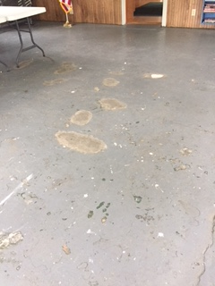
Assembly Hall’s Current Condition
Floor
  High moisture content prevents repair
  Large chunks continue to break out, causing potential trip hazard
  The floor will need to be replaced

Slide 8
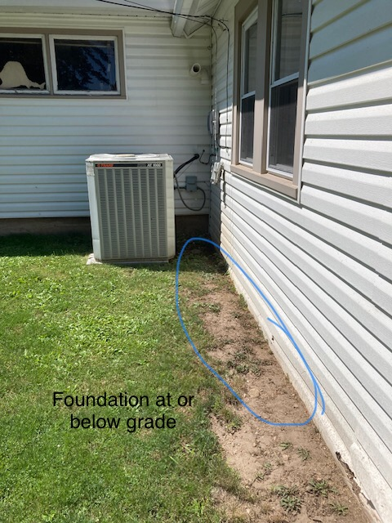
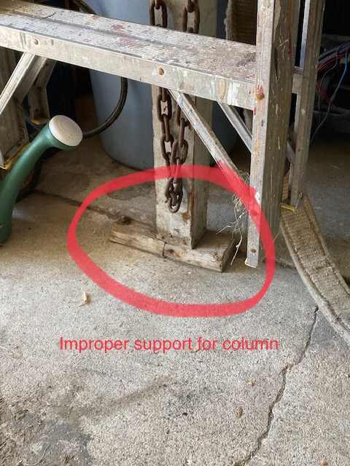
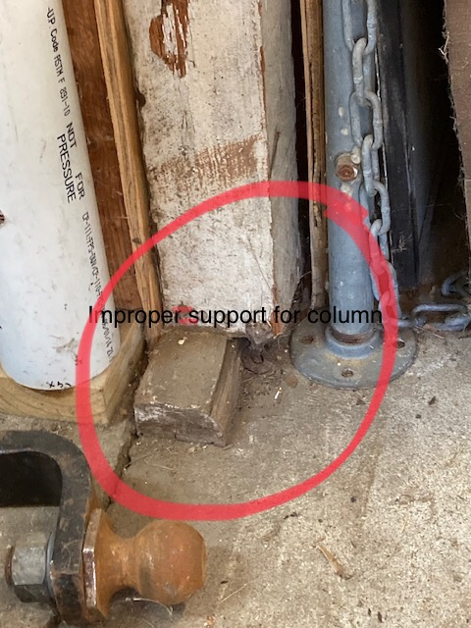
Assembly Hall’s Current Condition
Structural
  Issues with the current foundation
  Structural supports are not to code

Slide 9
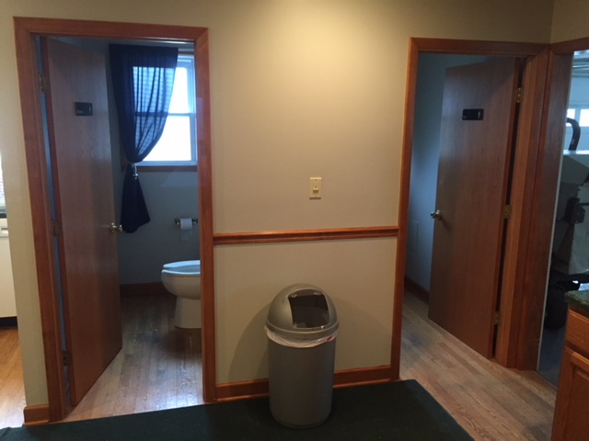
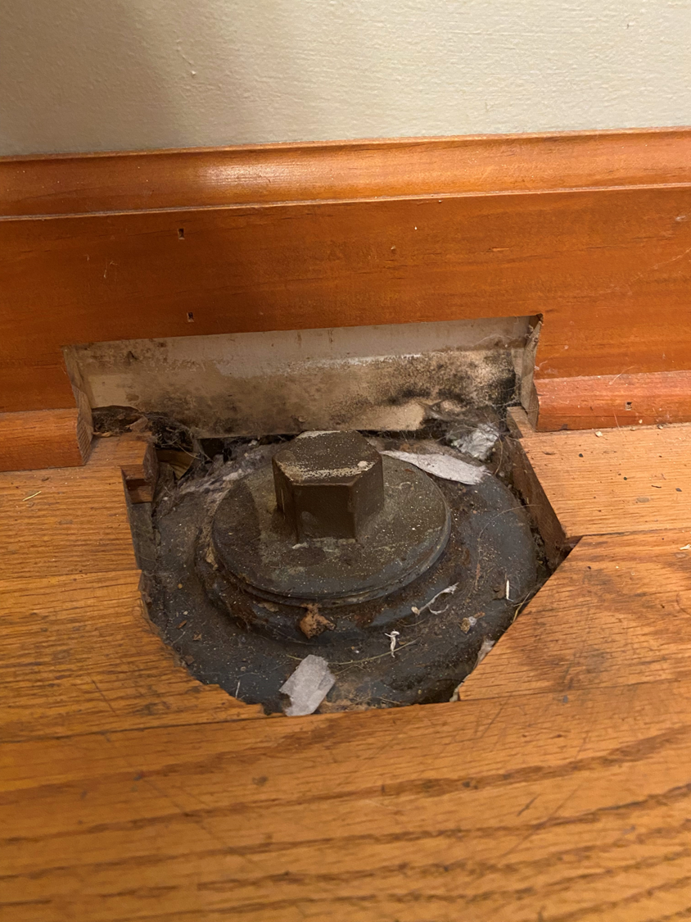
Assembly Hall’s Current Condition
Bathrooms
  ADA compliance (~29” opening at present versus 36” requirement)
  Health concerns with location to food preparation in Kitchen
  Improved access for members / guests
  Mold starting in one of the bathrooms

Slide 10
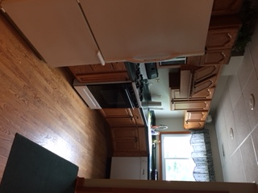
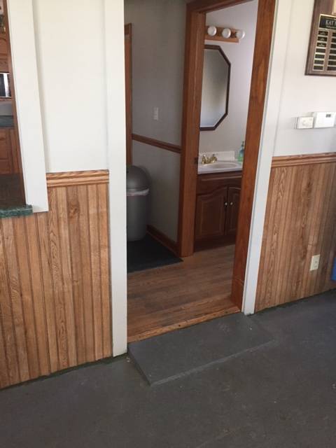
Assembly Hall’s Current Condition
Kitchen
  Worn surfaces, cabinetry, and appliances
  Difficult to keep systems operating and leak free, potential of mold.
  Floors need repair or replacement with a surface designed for high traffic and proper cleaning.

Slide 11
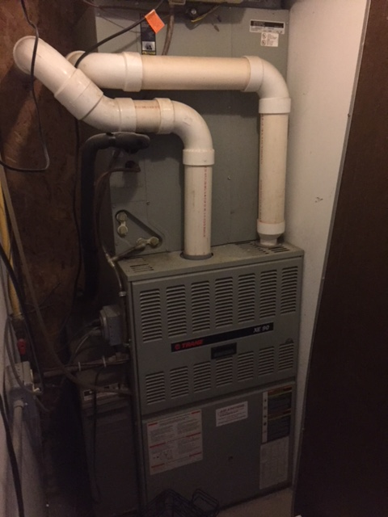
Assembly Hall’s Current Condition
HVAC
  The furnace was replaced in May of 2020 ($2,100)
  The AC does not work

Slide 12
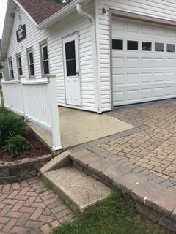
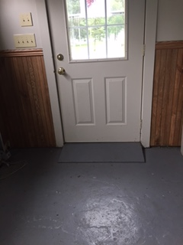
Assembly Hall’s Current Condition
Entrances
  Not ADA compliant
  Sidewalk has obstructed access.

Slide 13
Assembly Hall’s Current Condition - Summary
Roof, deck, and rafter replacement & associated exterior work
Insulation replacement with increased R-value
Structural supports not to code
Water damage and mold
Bathrooms ADA compliant
HVAC System and Ducting
Kitchen
Floor replacement
Entrances are not ADA compliant and constrictive
West exterior wall has seepage when it rains
More efficient use of space

Slide 14
Assembly Hall’s – Repair Existing Structure
Consider repairing the existing building
  We will need to bring the building up to code
    Roof
    Floor
    Structure
    Insulation
  Finding a contractor will be difficult
    Time and Material vs Fixed Cost
    Expect surprises – Time is money
    If a new code violation is found after remodeling starts it must be repaired
  The building continues to age and will require increasing on-going maintenance
  Requires significant improvements in next few years or more significant costs will be incurred
  Does not meet expectation and needs of members

Slide 15
Assembly Hall’s – Replacement
Consider the teardown and replacement of existing building
  Meet current building codes
  ADA accessible entrance, facility and washrooms
  Remediate structural, electrical, mechanical and R-value issues long-term
  Resolve on-going concern for slips, trips and falls issues with existing facility at entrance, throughout facility and washrooms
  Enhance and harden surfaces throughout, while improving aesthetics
  Improve the view of lake and park, while using the hall
  Reduce annual operating cost of maintaining structure and energy costs
  Expanding space for utilization at annual meeting and on-going events in conditioned controlled environment
  Increased storage space for equipment
  Increased home values through this investment in our community
  Improve the communities experience, with increased activities to drive community events, fundraising and community interaction

Slide 16
Assembly Hall’s – Replacement Versus Repairing
Consider the teardown and replacement of existing building
  New facility will increase useable space
    Basement storm shelter
    Expanded garage space
    Community area for socializing
  Addresses the issues
    Ergonomic, slip, trips & falls
    ADA
    Energy conservation
    Code Compliance
    Safety
  Need to plan now as current condition is not sustainable.

Slide 17
Assembly Hall
We asked the Auxiliary to Recommend Uses and Wants for the Hall
Past Uses:
  Wedding Showers
  Weddings
  Baby Showers
  Birthday Parties
  Graduation Parties
  Anniversary Parties
  Family Thanksgivings
  Christmas Parties
  NYE Parties
  Halloween Party
  Spaghetti Dinners
  Pancake Breakfast
  Annual Meetings
  Ladies Luncheons
  Children’s Dances
  Family Reunions
  Arbor Day
  Garden Parties
  Bingo
  Card Parties
  Bunco
  Big Ticket Raffle
  Ice Cream Social
  Tuesday Cocktails
  Pampered Chef Party
  Elvis
Future Uses:
  Multipurpose Space
  Yoga/Play area
  Coffee/Meeting area
  Movie Night
  Concert in the Park
  Storm Shelter
Wants:
Covered outdoor area
  View out to the lake
  Technology
  Chest Freezer for Ice
  Permanent Location for AED
  Commercial Like Kitchen
  Larger/more practical Kitchen
  No Dishwasher
  Bathroom w/ multiple stalls
  Mailroom
  Upgraded Electric
  Built in sound system
  AC/Heat
  Storage for tables and chairs
  Ice Maker?
  Security Cameras
  Personalized Door Codes
  Library
Additional Thoughts:
  Set schedule or sign ups?

Slide 18
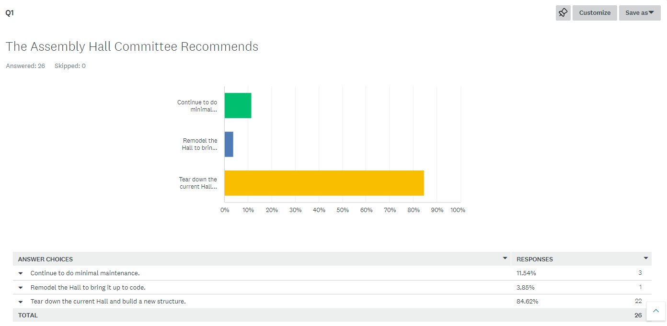
Assembly Hall Committee Survey Results
32 Total Surveys Sent
Surveys Received 81% Responded

Slide 19
Assembly Hall - Walk The Hall
Walk the Hall – Saturday 9/30 8:00am to 10:00am:
The Assembly Hall Committee believes that it is important for all of us to be informed as to the current condition of the Hall. So, in addition to the scheduled special meeting presentation on September 26th at 7:00pm the committee would like to invite you to “Walk the Hall” on Saturday September 30th from 8:00 am to 10:00 am.

